Slide 1
Employee Data Analysis using Excel
STUDENT NAME: THISHA G
REGISTER NO : E634605A26A49D7897841C81315FE99E, 312208805
DEPARTMENT : B.COM (GENERAL)
COLLEGE : MEENAKSHI COLLEGE FOR WOMEN

Slide 2
PROJECT TITLE
Employee Performance Analysis Based on Department, Gender and FTE using Excel

Slide 3

AGENDA
Problem Statement
Project Overview
End Users
Our Solution and Proposition
Dataset Description
Modelling Approach
Results and Discussion
Conclusion
3/21/2024 Annual Review

Slide 4

PROBLEM STATEMENT To analyze the performance of employees within an organization by examining various factors such as department, gender and full-time equivalent (FTE) status using Excel.

Slide 5

PROJECT OVERVIEW
To analyze the performances of employees within an organization by examining various factors such as department, gender and full-time equivalent (FTE) status using Excel. This analysis will ultimately help the organization to improve the overall effectiveness of the workforce.

Slide 6
WHO ARE THE END USERS? 1. TEAM LEADERS AND SUPERVISORS 2. EMLOYEES 3. EXECUTIVE LEADERSHIP 4. BUSINESS ANALYSTS 5. RECRUITERS

Slide 7

OUR SOLUTION AND IT'S VALUE PROPOSITION PIVOT TABLE – SUMMARY OF EMPLOYEE PERFORMANCE BAR DIAGRAM – FINAL REPORT

Slide 8
Dataset Description EMPLOYEE DATA SET – NAN MUDHALVAN PORATAL 9 FEATURES IN EXCEL: EMPLOYEE ID – ALPHANUMERIC (TEXT) NAME – ALPHABETICAL (TEXT) GENDER – ALPHABETICAL (TEXT) DEPARTMENT – ALPHABETICAL (TEXT) SALARY - NUMERICAL START DATE – ALPHANUMERIC (TEXT) FTE - NUMERICAL EMPLOYEE TYPE – ALPHABETICAL (TEXT) EMPLOYEE LOCATION – ALPHABETICAL (TEXT) 3 FEATURES USED: DEPARTMENT – ALPHABETICAL (TEXT) FTE - NUMERICAL GENDER – ALPHABETICAL (TEXT)

Slide 9

THE "WOW" IN OUR SOLUTION
Effective data visualization makes it easier to present complex data in an engaging and understandable way.
Well-presented data can have a significant impact on decision-makers, helping to drive change and innovation.
3/21/2024 Annual Review
9

Slide 10
MODELLING
STEP-1
DOWNLOAD THE EMPLOYEE DATASET AND OPEN THE EMPLOYEE DATASET IN EXCEL.
STEP-2
SELECT THE ENTIRE DATA AND CLICK ON INSERT AND CLICK ON PIVOT TABLE TO CREATE PIVOT TABLE.
STEP-3
DRAG THE NEEDED DATA AND CREATE A PIVOT TABLE.
10

Slide 11
STEP-4
SELECT THE PIVOT TABLE AND CLICK ON
INSERT.
STEP-5
NOW CLICK ON THE CHART THAT YOU WANT.
STEP-6
THE CHART IS CREATED.

Slide 12
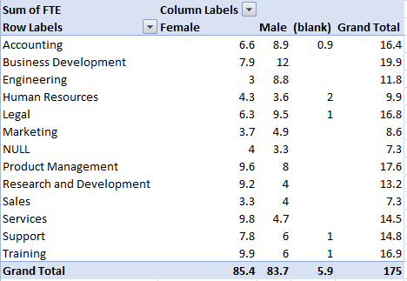
RESULTS 1.TABLE
12

Slide 13
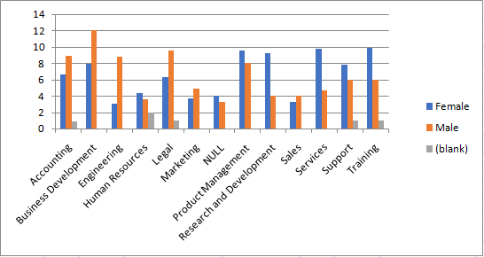
2.BAR DIAGRAM

Slide 14
Conclusion
Based on the performance analysis conducted across various departments, genders, and FTE statuses, several key insights have emerged which could contribute to the overall efficiency of the organization. Overall, the analysis provides a clear picture of performance dynamics within the organization, highlighting areas of strength and opportunities for targeted improvements.

